Slide 1

Gym Booking Management System
Flipkart JEDI Program –
Capstone Project

Slide 2
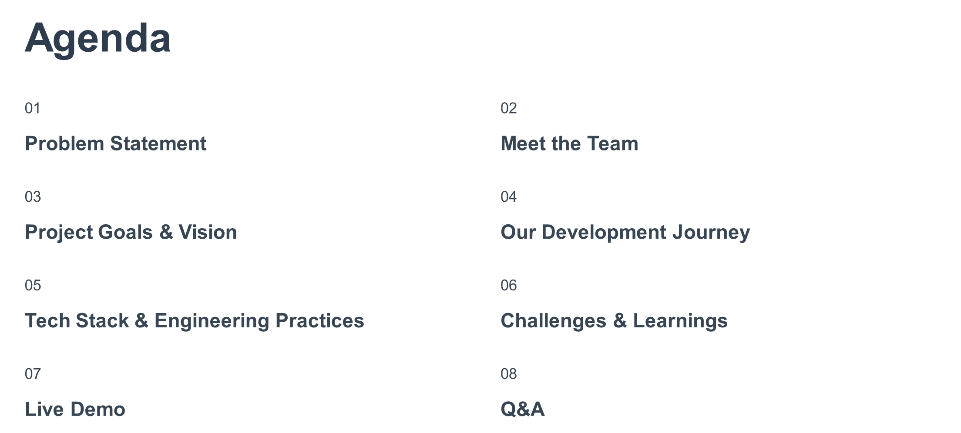

Slide 3
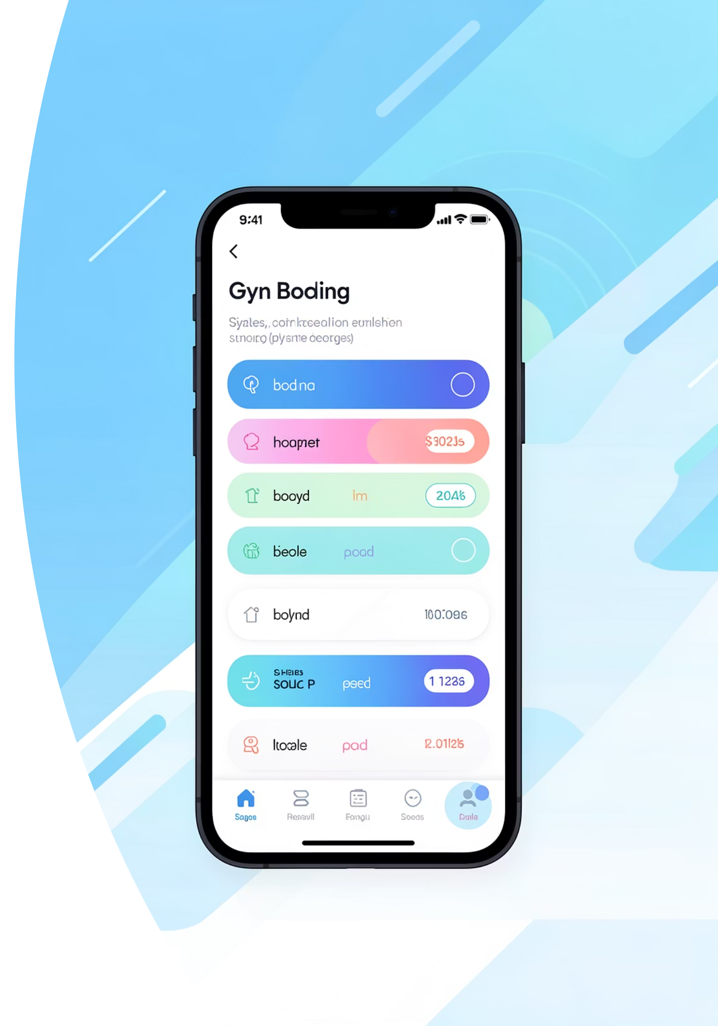
The Problem Statement
To digitize manual and inefficient gym operations into a centralized, scalable, and persistent web service. The system replaces volatile data tracking with a robust architecture to manage real-time bookings, automated waitlists, and distinct workflows for Admins, Owners, and Customers.
Slot Availability
Gym Verification
Real-time booking and waitlisting
Admin approval and validation
Centralized Management
Unified platform for all stakeholders

Slide 4


Slide 5
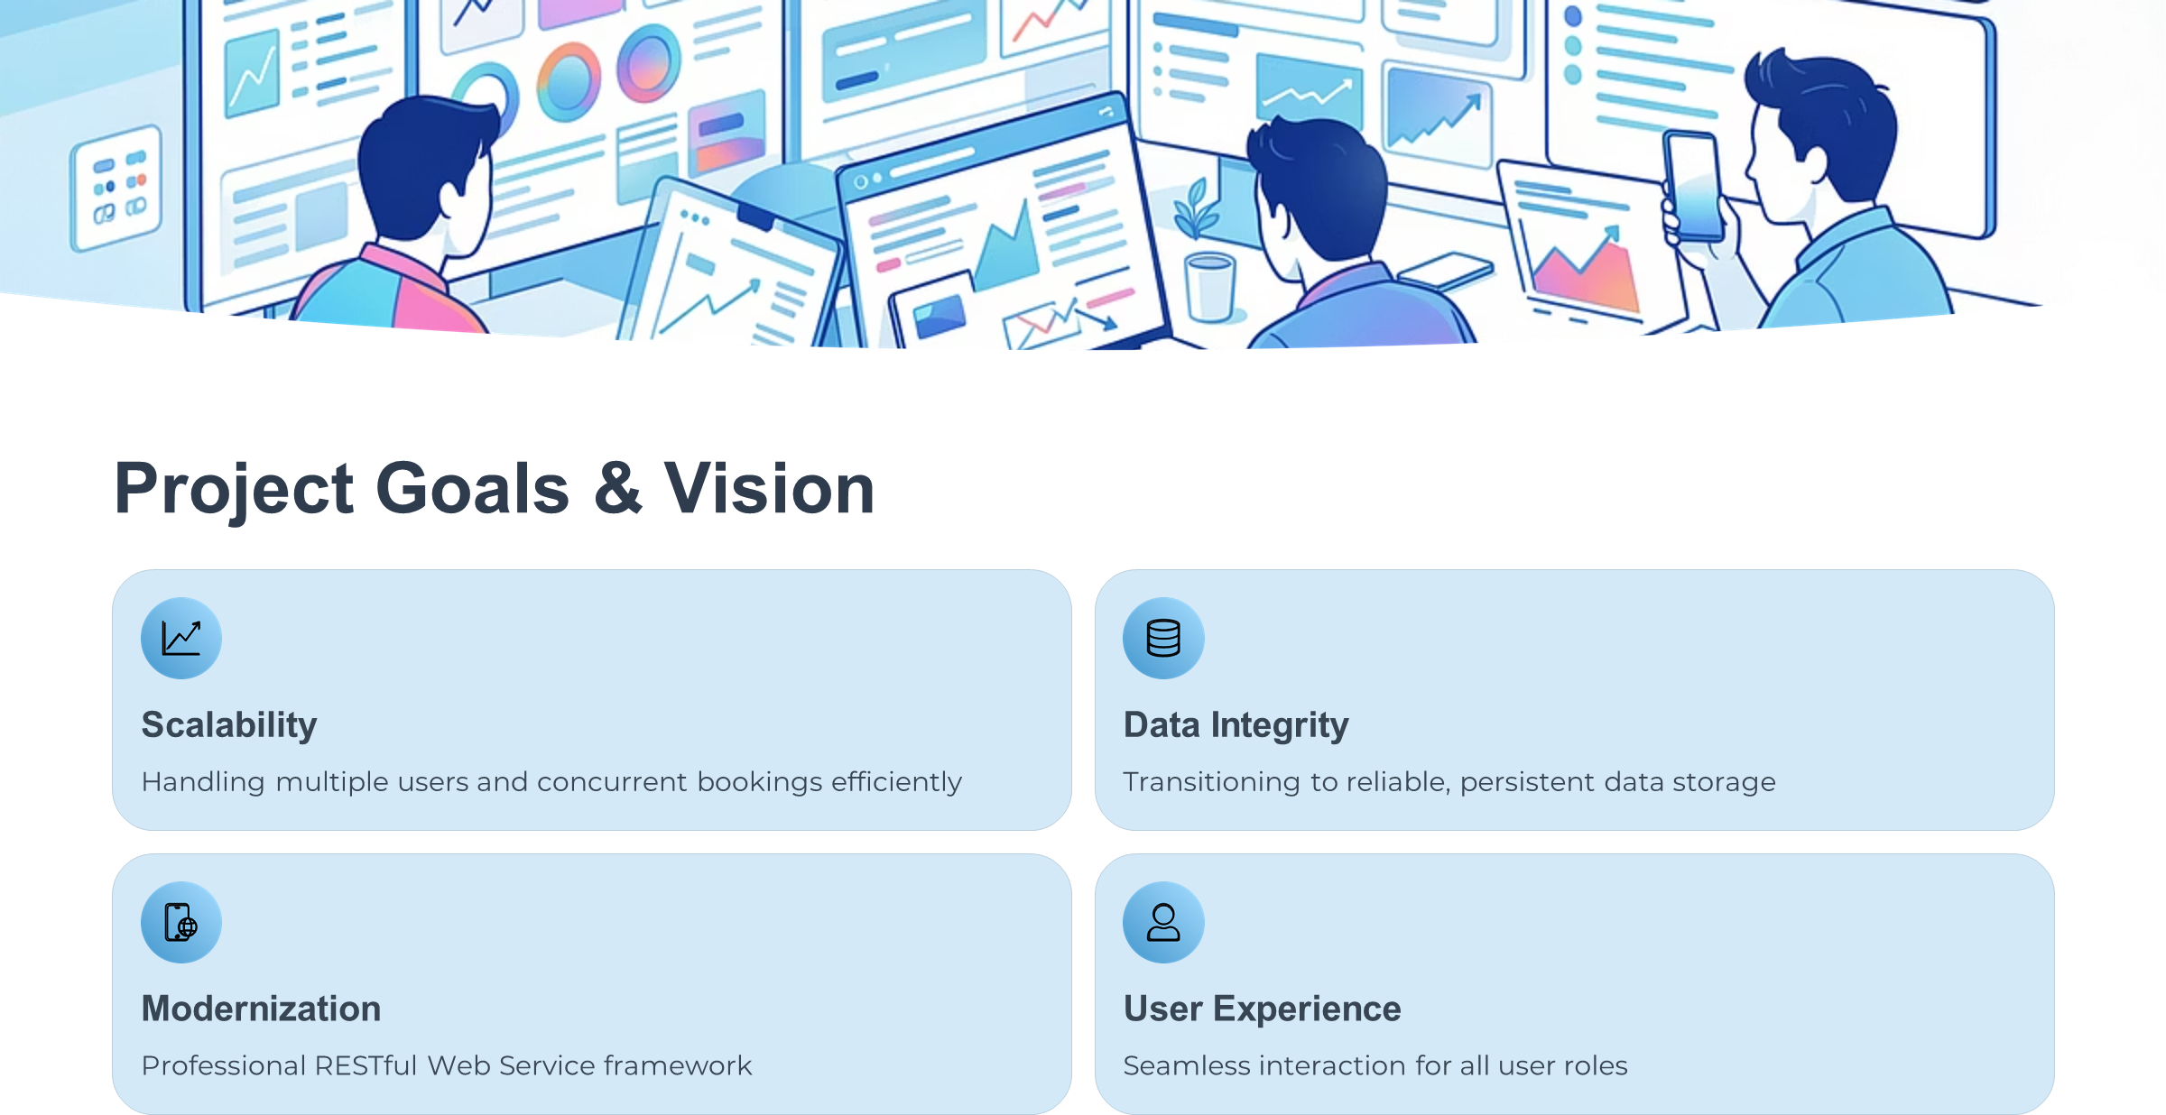

Slide 6
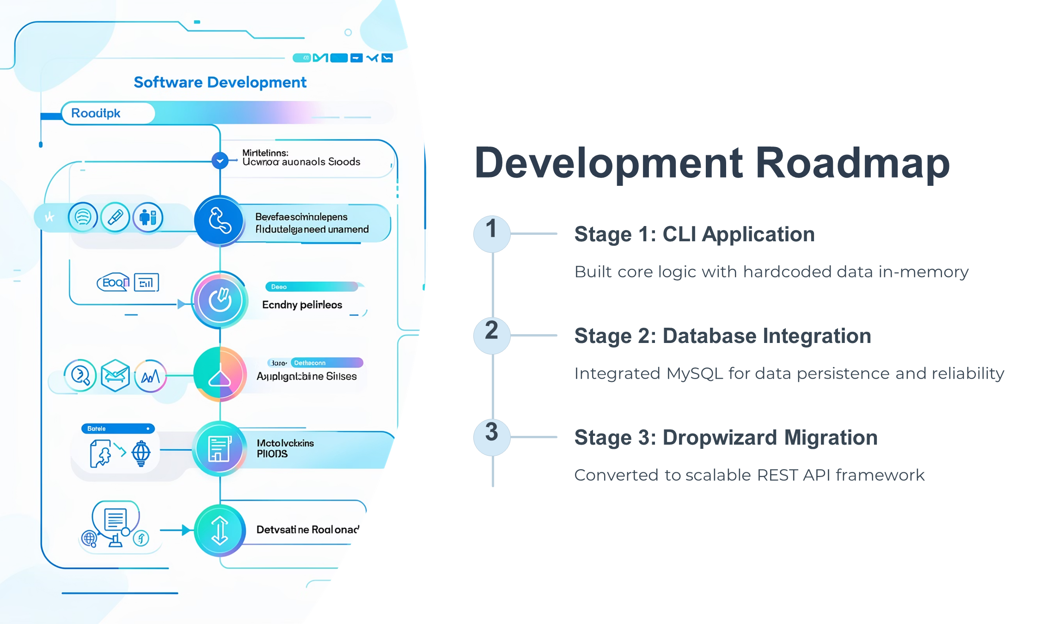

Slide 7
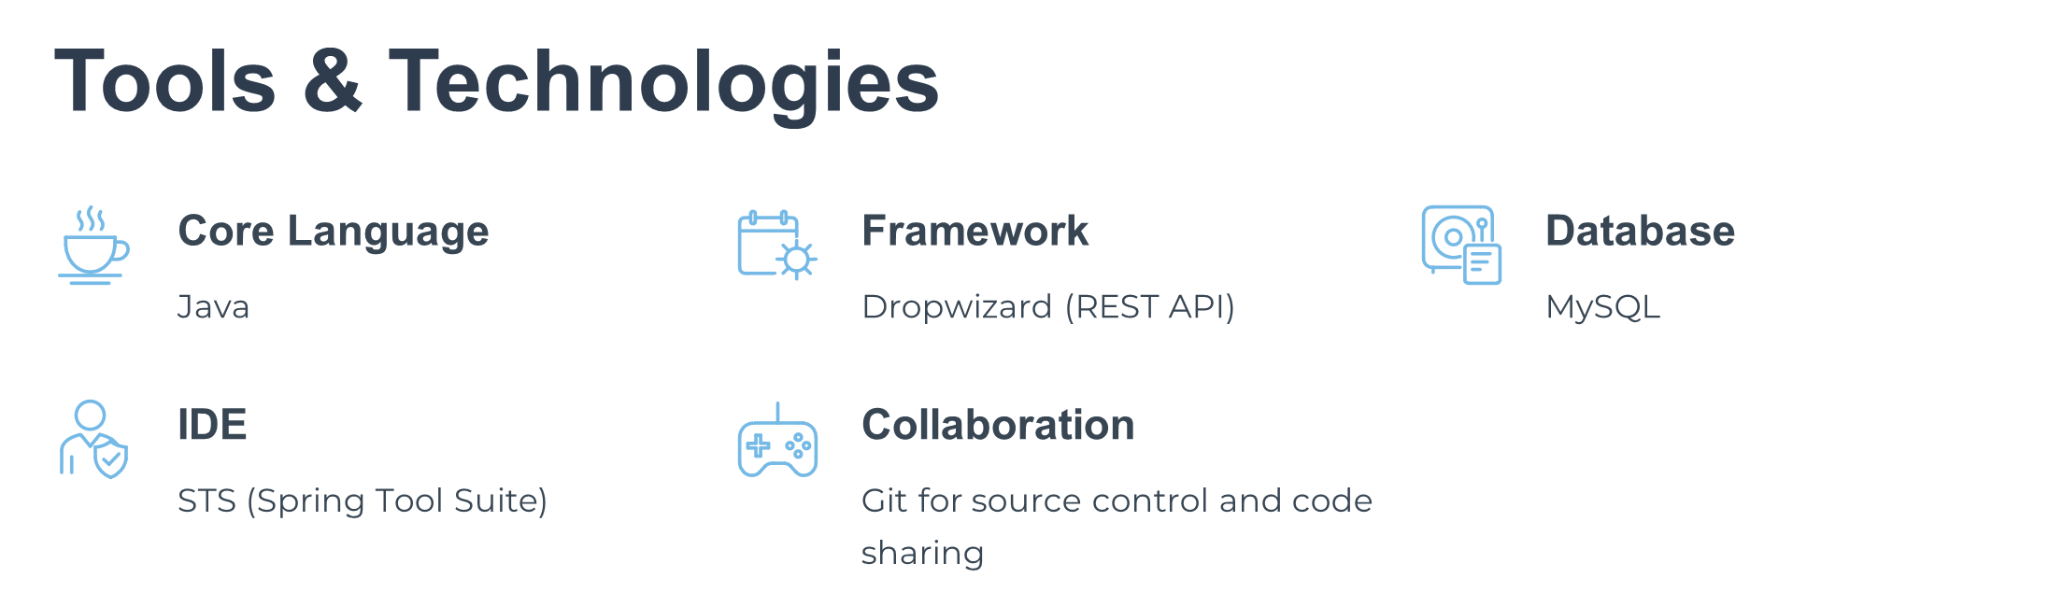

Slide 8
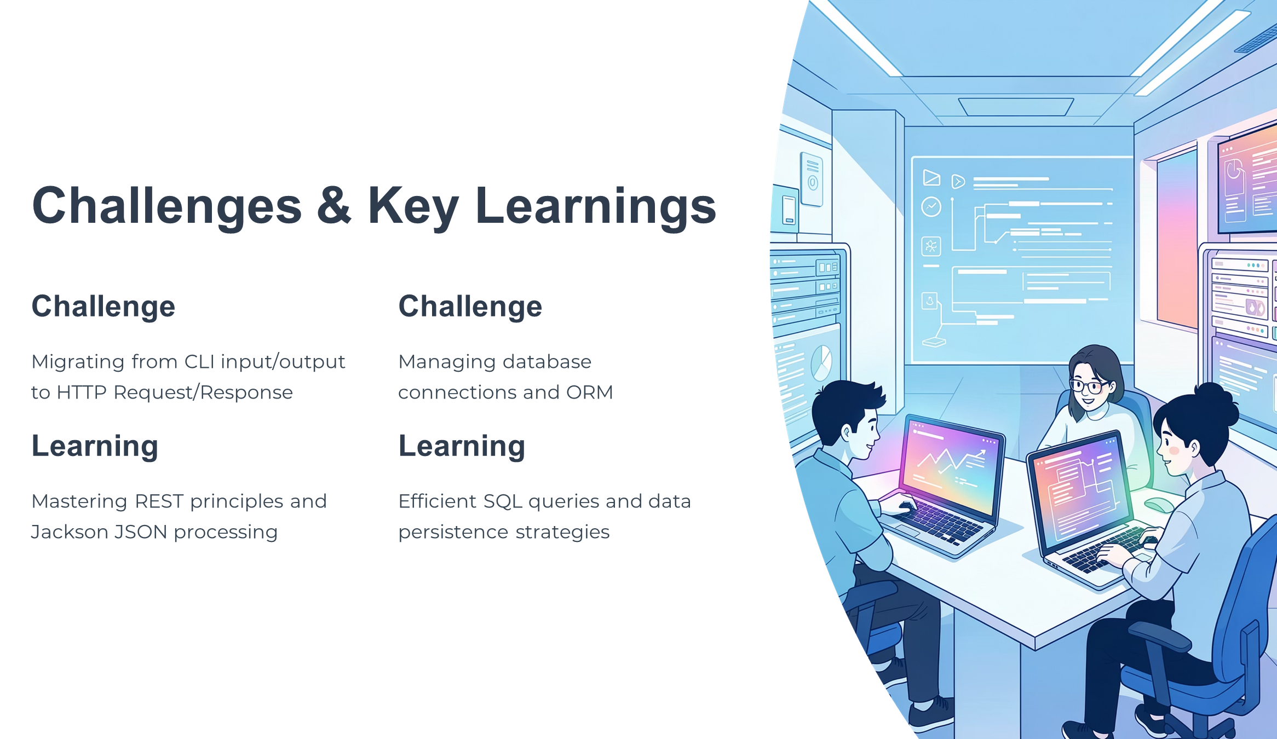

Slide 9


Slide 10


